Slide 1


Improving Linux Load Balancer
Boaz Haim
Supervisor- Noam Shalev
Spring 2015

Slide 2
Background
Linux is an open source Operating System
Linux Kernel is the “heart” of Linux.
Linux can work on many types of computers, the computers can have 1,2,4 or more CPU’s.
The Kernel controls the amount of jobs each CPU has
This is done by the scheduler and the load balancing mechanism.

Slide 3
The Problem
Current implementation of Linux load balancer does not consider offline cores which can result in an unbalanced CPU’s

Slide 4
Project milestones
Prove the problem
Study and present a solution
Validate the solution

Slide 5
Proving the problem
Created a tool to test all the CPU’s load work using timers and kernel system call.
We started by creating many task in the system
Shutting down one of the CPU’s
Then every pre defined time, going over each of the CPU’s and writing its run queue size

Slide 6
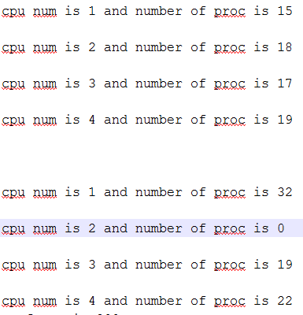
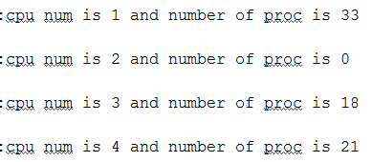
Sample outputs from the tool
The moment of shutting down a CPU(number 2)
CPU’s state after some time

Slide 7
Balanced state

Slide 8
Research
The balancer is working with sched_domain data structure. This helps the kernel with an abstraction to work with the CPU’s.

Slide 9
Sched_domain- example
Sched_domain
Cpu 0/1/2/3/4/5/6/7
Sched_domain
Cpu 0/1/2/3
Sched_domain
Cpu 4/5/6/7
Sched_domain
Cpu 0/1
Sched_domain
Cpu 2/3
Sched_domain
Cpu 4/5
Sched_domain
Cpu 6/7
cpu0
cpu1
cpu2
Cpu3
cpu4
cpu5
cpu6
cpu7

Slide 10
Suggested Solution
Each Sched_domain calculates the average work per CPU. This formula doesn't take under consideration the case of offline CPU
The solution will update the data structures and function to check the average work only with the online CPU’s

Slide 11
Example
Old group AVG
New group AVG
Group 1
Group 2
Group 1
Group 2
Group 1
Group 2
10
10
10
10
10
10
10
10
20
0
10
10
10
10
20
10
18
0
11
11
9
11
18
11
16
0
12
12
8
12
16
12
14
0
13
13
7
13
14
13

Slide 12
What triggers the load balance
It has two methods of invocation. It is called by schedule() whenever the current runqueue is empty. It is also called via timer: every 1 millisecond when the system is idle and every 200 milliseconds otherwise

Slide 13
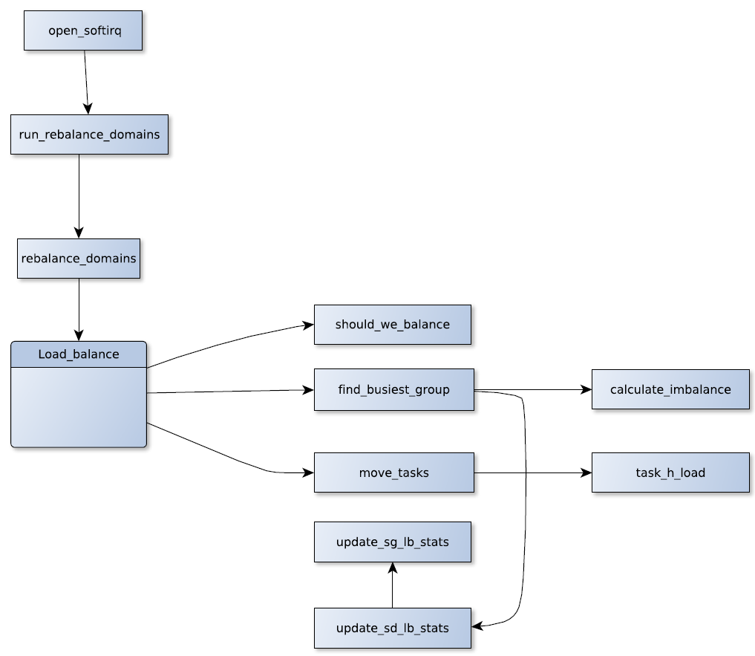
Load_balance- overview

Slide 14
Data structures and their changes
Sched_domain -this is the main data structure that represents the kernel abstraction for the cup's, each sched_domain conations sched_groups.
Sched_group (CPU groups)- contains the group power(which actually represents the group capacity) and has representor for all the cpus in the group.

Slide 15
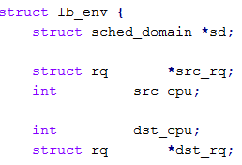
Lb_env (load balance environment) this helps to represents a group of cpus we consider for the load balance.
A few fields from the structure

Slide 16
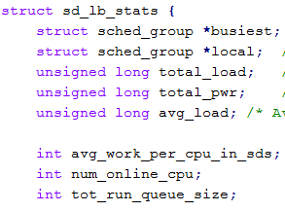
Sd_lb_stats - Structure to store the statistics of a sched_domain during load balancing.
My addition
A few fields from the structure
Sg_lb_stats -stats of a sched_group required for load balancing. Contains detailed information about the group

Slide 17
How the load balance works and the changes
First we start by checking if there is a need to balance, by calling: should_we_balance:
Goes over all the CPU’s in the group and checks if there is a CPU that needs to be balanced.

Slide 18
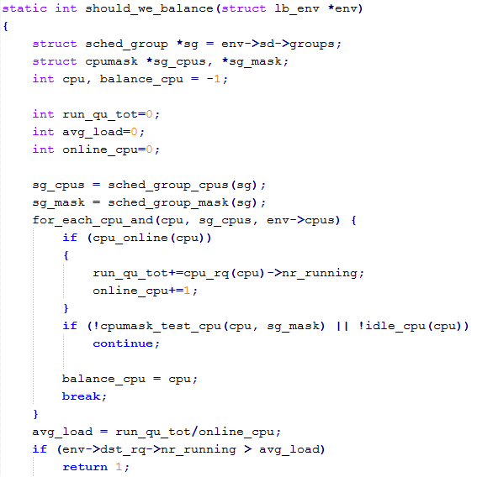
My addition
The function continue with the original statements

Slide 19
How the load balance works and the changes cont
If we decided that there is an imbalance within the domain, we call to find_busiest_group

Slide 20
Find_busiest_group
Returns the busiest group within the sched_domain, if there is an imbalance it also calculates the amount of weight load which should be moved in order to restore the balance.
The formula for the amount of tasks to move had to be changed

Slide 21
Summary
Checking if there is a group that needs rebalance
Find the group
Calculate the number of tasks to move
And then…
Now, the load_balance gets the specific CPU to take the tasks from
Lock the source and destination CPU’s run queue
Calls the move_tasks function

Slide 22
Move_tasks
The function goes over all the tasks in the busiest CPU and try to move them (stops when at the end or when moved the amount needed)
Calles task_h_load

Slide 23
Task_h_load
Task hierarchical load- Calculates the relevant load of the task.
The result is checked, and if the result/2 is bigger than the imbalance(amount of tasks to move), we wont try to move this task(in order not to move big tasks).
In the testing, this check always return true and we never moved any tasks.
This was caused mainly because of the way the imbalance calculation was changed.

Slide 24
Actual result after all the changes
Balanced state
Almost idle balance
Core1 shutdown

Slide 25


When adding a new task
State before new task creation
State after new task creation

Slide 26
Conclusions
The load balance is a complicated algorithm.
By changing a few functions in the load balancing mechanism we were able to achieve proper load balancing in a case of offline CPU, which is not supported in the current Kernel versions.
The whole project was done on v3.14, in the newer versions the load_balace section is being remodeled and improved.

Slide 27
References
Bovet, D., & Cesati, M. (2005). Understanding the Linux kernel (3rd ed.). Beijing: O'Reilly.
Mauerer, W. (2008). Professional Linux kernel architecture. Indianapolis, IN: Wiley Pub.
Linux Load Balancing Mechanisms-NTHU Institution- http://nthur.lib.nthu.edu.tw/bitstream/987654321/6898/13/432012.pdf
Kernel Documentation: https://www.kernel.org/doc/Documentation/scheduler/sched-domains.txt
Seeker, V.(2013). Process Scheduling in Linux. University of Edinburgh http://criticalblue.com/news/wp-content/uploads/2013/12/linux_scheduler_notes_final.pdf

Slide 28

Questions?

